Slide 1

WaveCon Telecom Analysis Insights on 5G Launch in India since June, 2022
Faraz Ahmed
Virtual Internship CodeBasics Bootcamp

Slide 2

WaveCon Telecom is among the leading telecommunication company in India having a network spread in 15 cities of India. They are the 3rd largest company as per market share. In June, 2022 they launched 5G and seek the overall impact on their performance. Hence, CodeBasics team has been assigned the task to analyze the overall data before and after launch of 5G and provide insights.
WaveCon Telecom Analysis
Faraz Ahmed
Virtual Internship CodeBasics Bootcamp

Slide 3

Data of 8 months period has been provided out of which first four months (from January, 2022 till April, 2022) is before launch of 5G, whereas, last four months (from June, 2022 till September, 2022) is covering the period after launch of 5G. The data sets provide month wise revenues in terms of cities & packages but also the market share among their competitors. Moreover, it also provides date wise position of active users and unsubscribed users.
WaveCon Telecom Analysis
Understanding the Data:
Faraz Ahmed
Virtual Internship CodeBasics Bootcamp

Slide 4

WaveCon Telecom Analysis
Main KPIs Before and After the Launch of 5G:
Before 5G:
Revenues: ₹16.0Bn
Average Revenue Per User : ₹ 190
Authorized Users: 84.4M
Unsubscribed Users: 5.6M
Market Share: 19.43%
After 5G:
Revenues: ₹15.9Bn
Average Revenue Per User : ₹ 211
Authorized Users: 77.4M
Unsubscribed Users: 7.4M
Market Share: 17.84%
Faraz Ahmed
Virtual Internship CodeBasics Bootcamp

Slide 5
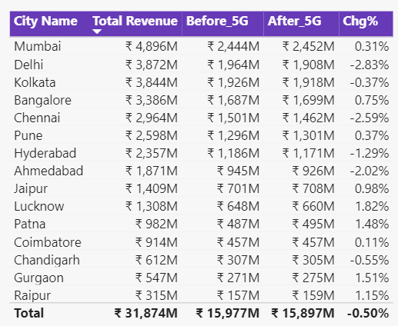
WaveCon Telecom Analysis
Addressing the Questions
Question 1:
What is the impact of the 5G launch on our revenue?
The revenues have declined by an amount of ₹100Mn (0.50%)
Faraz Ahmed
Virtual Internship CodeBasics Bootcamp

Slide 6
WaveCon Telecom Analysis
Addressing the Questions
Question 2:
Which KPI is under- performing after the 5G launch?
The unsubscribed users have increased from 5.6Mn to 7.4Mn i.e. a rise of over 32%.
The active users have declined from 84.4M to 77.4M i.e. a decrease of over 8%.
The revenues have declined from ₹16.0Bn to ₹15.9Bn i.e. a decrease of 0.5%.
Market share has declined from 19.43% to 17.84%
Faraz Ahmed
Virtual Internship CodeBasics Bootcamp

Slide 7
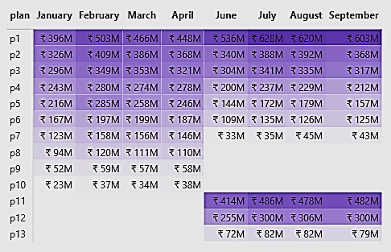
WaveCon Telecom Analysis
Addressing the Questions
Question 3:
After the 5G launch, which plans are performing well in terms of revenue? Which plans are not performing well?
Well Performing Plan(s): P1 (increase of 25%)
Under Performing Plan(s): P7 (decrease of 73%), P5 (decrease of 35%), P6 (decrease of 34%), P4 (decrease of 20%)
Plan(s) with no Change: P2, P3
Faraz Ahmed
Virtual Internship CodeBasics Bootcamp

Slide 8
WaveCon Telecom Analysis
Addressing the Questions
Question 4:
Is there any plan affected largely by the 5G launch? Should we continue or discontinue that plan?
Plan P7 is among the hugely impacted plans since launch of 5G as it has witnessed a huge decline of 73% as compared to revenues generated before 5G launch. The program may be discontinued and instead launch a new plan.
Faraz Ahmed
Virtual Internship CodeBasics Bootcamp

Slide 9
WaveCon Telecom Analysis
Addressing the Questions
Question 5:
Is there any plan that is discontinued after the 5G launch? What is the reason for it?
Plan P8, P9 & P10 were discontinued after launch of 5G. The reason was low revenue generation. The company instead launched new plans namely P11, P12 & P13 which were successful and earned reasonable revenues which resulted in compensation of revenue decreased by existing plans.
Faraz Ahmed
Virtual Internship CodeBasics Bootcamp

Slide 10
WaveCon Telecom Analysis
Addressing the Questions
Question 5:
Is there any plan that is discontinued after the 5G launch? What is the reason for it?
Plan P8, P9 & P10 were discontinued after launch of 5G. The reason was low revenue generation. The company instead launched new plans namely P11, P12 & P13 which were successful and earned reasonable revenues which resulted in compensation of revenue decreased by existing plans.
Faraz Ahmed
Virtual Internship CodeBasics Bootcamp

Slide 11
WaveCon Telecom Analysis
Challenges:
We consider that following are the challenges faced by the company:
Their market share in comparison to their peers have declined
Decrease in revenues despite increase in average revenue per user
Active users have decreased significantly
Unsubscribed users have increased hugely
Out of the 7 old plans only 1 plan is showing increase in revenues, whereas, majority of plans are showing decline.
Moreover, 3 old plans been discontinued due to decreasing revenues.
Faraz Ahmed
Virtual Internship CodeBasics Bootcamp

Slide 12
WaveCon Telecom Analysis
Positives:
Despite negative trends with respect to market share, revenues, active users & unsubscribed users, following are the positive aspects for the company:
They still possess third largest market share and the next company in the list is far beyond in market share
Decline in revenue is nominal and can be turnaround with little effort
The average revenue per user has increased by more than 11%
The new plans introduced since 5G launched have performed exceptionally
Faraz Ahmed
Virtual Internship CodeBasics Bootcamp

Slide 13
WaveCon Telecom Analysis
Recommendations:
To either close or update the existing plans and introduce new plans to attract customers.
To introduce schemes & benefits to unsubscribed users to convert into active users
Concessions and free features to new users to increase number of active users
To improve & upgrade their service
Reduce the charges (optional)
Faraz Ahmed
Virtual Internship CodeBasics Bootcamp

Slide 14
Thank You!
WaveCon Telecom Analysis
Faraz Ahmed
Virtual Internship CodeBasics Bootcamp

